Slide 1
Mac OS
Nick Yokaitis, Andrew Pereira, Nathan Padinha, Logan Regueiferos

Slide 2

Who owns MacOS/Where are they based
Owned and developed by Apple Inc.
Supported by Apple with regular updates and security patches
Apple's main headquarters are located in Cupertino, California, USA.
Additional offices and research facilities are located worldwide.
Notes:
Apple Inc., founded in 1976, is a technology company headquartered in Cupertino, California. With offices and research facilities worldwide, Apple has an international footprint. They push out regular updates, security patches, and cutting-edge technology for the mac platform. Apple has control over both Mac hardware and software.

Slide 3
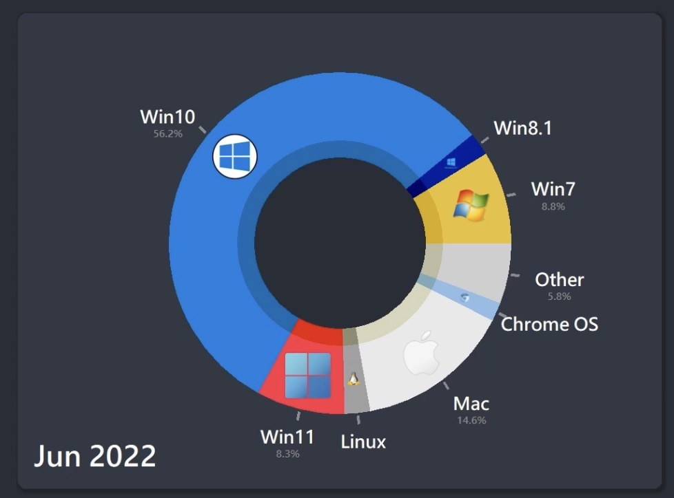
Current Version / Market Share
The current version of MacOS is MacOS 14- Sonoma
9.4% Market Share (Wikipedia)
Growing popularity in creative industries and education
Notes:
The current version is Mac OS 14 Sonoma. Apple tends to release a new version of MacOS each year. MacOS currently has a 9.4% market share in industry, MacOS is gaining popularity in the industries of graphic design and education. Apple has made significant investments in these fields to promote the use of the operating system.

Slide 4
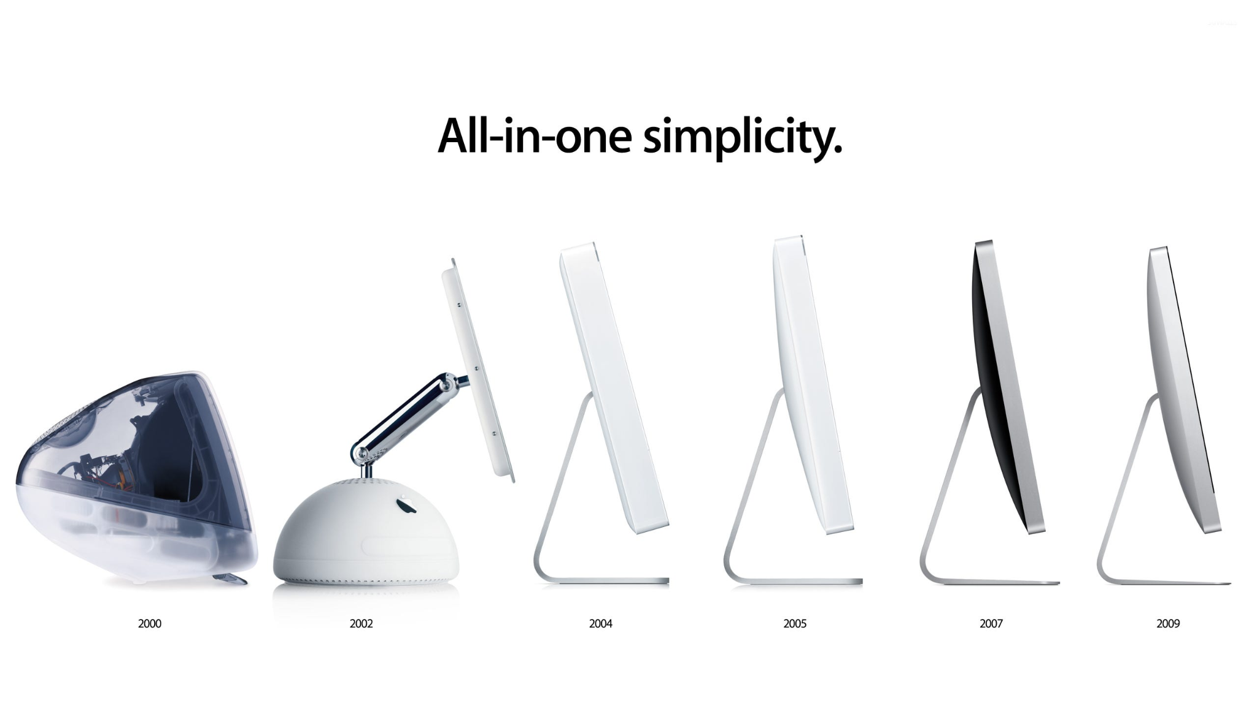
History Of MacOS
Creators: Steve Jobs & Steve Wozniak
Mac OS classic - January 24, 1984 - Macintosh line of Personal Computer
MacOS X - March 21, 2001 - iMac g3
OS X - July 20, 2011 - MacBook Pro Core i7" 2.8 13
Latest OS: MacOS - September 20, 2016 -

Slide 5
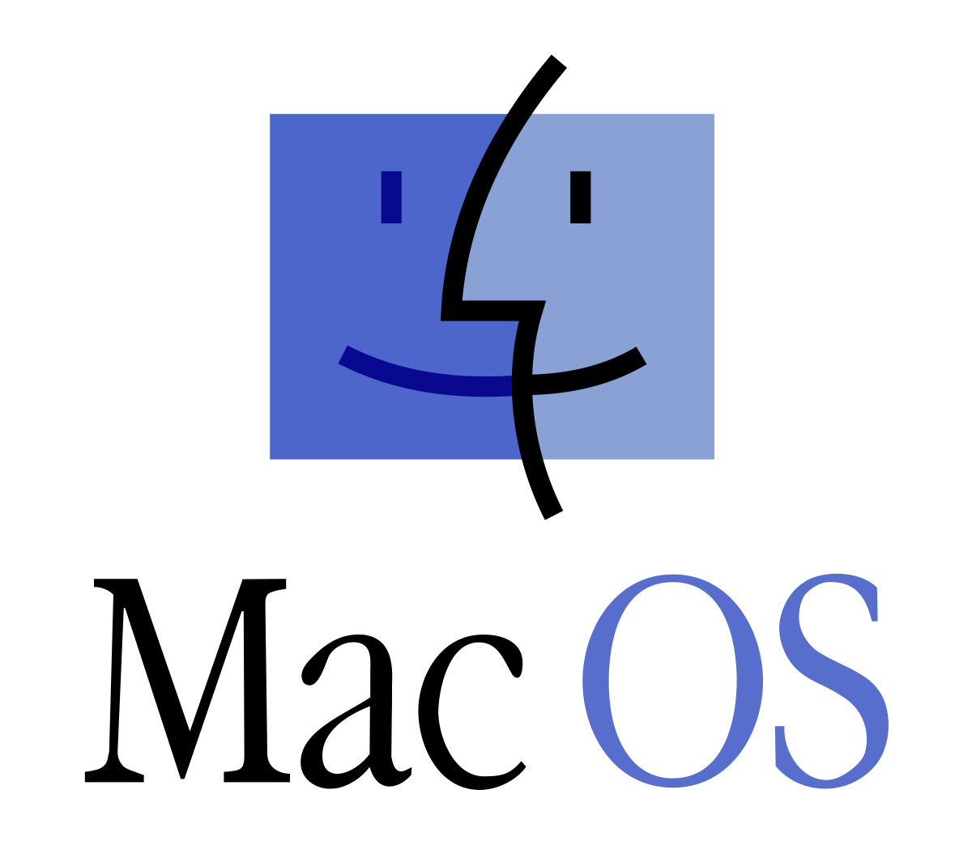
What does it support 32 or 64?
Supports 64-bit applications
Gradually transitioned to 64-bit only architecture
New Mac’s after 2020 only support 64-bit applications

Slide 6
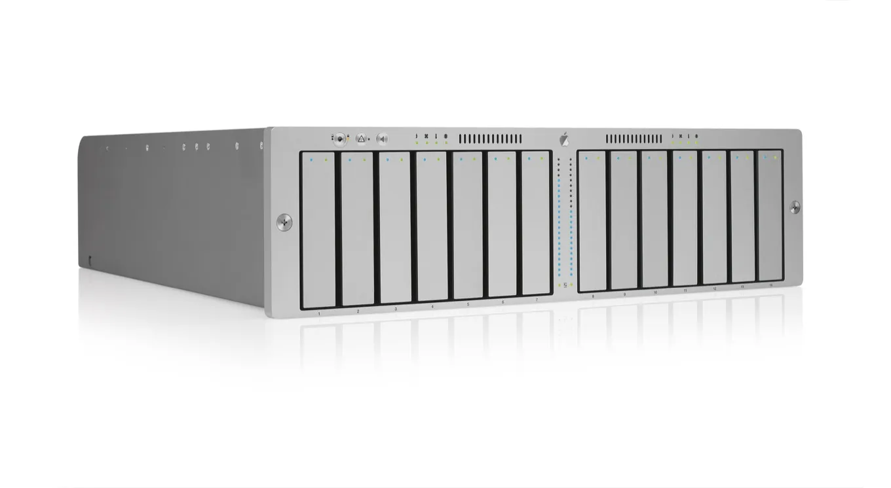
Server Operations
The MacOS server is no longer available
Servers were discontinued on April 21 2022
The life span of the server was March 24, 2001 - April 21 2022
Can function as a print server, file server, application server, web server, and more
Supports various network protocols and services

Slide 7
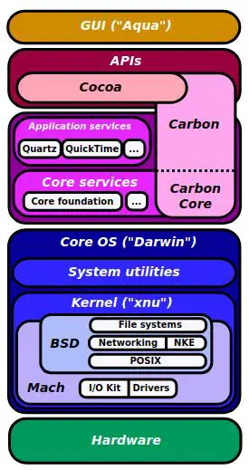
MacOS kernel
macOS uses the XNU kernel
Based on Mach microkernel and FreeBSD operating system
Provides core functionalities like memory management, process management, and device drivers

Slide 8
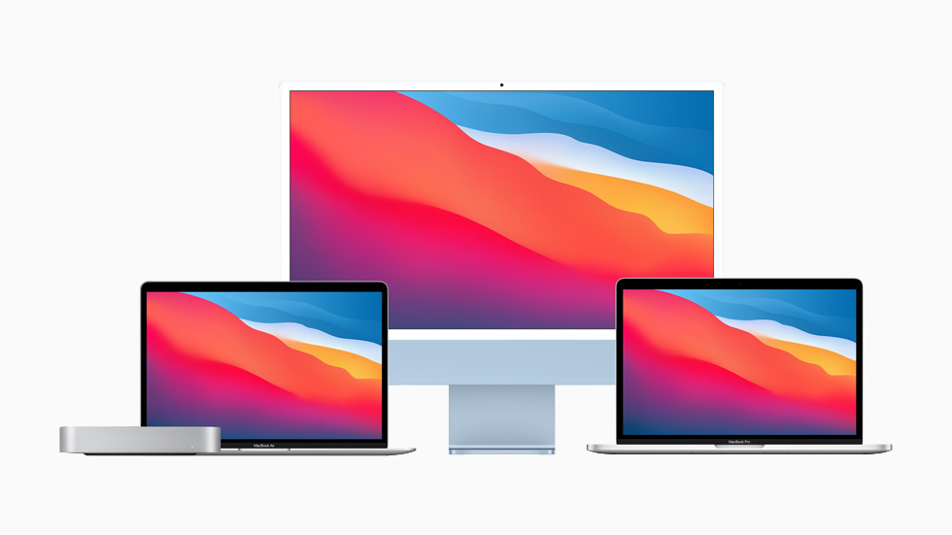
Hardware Requirements
Minimum hardware requirements depend on the specific macOS version
Generally requires an Apple computer or laptop with Intel or Apple Silicon processor

Slide 9

Cost of Software
macOS is free to upgrade for existing Apple devices
New devices come pre-installed with the latest version

Slide 10

Cost of Hardware
Apple devices vary in price depending on model, specifications, and configuration
Generally considered more expensive than some other computer brands

Slide 11
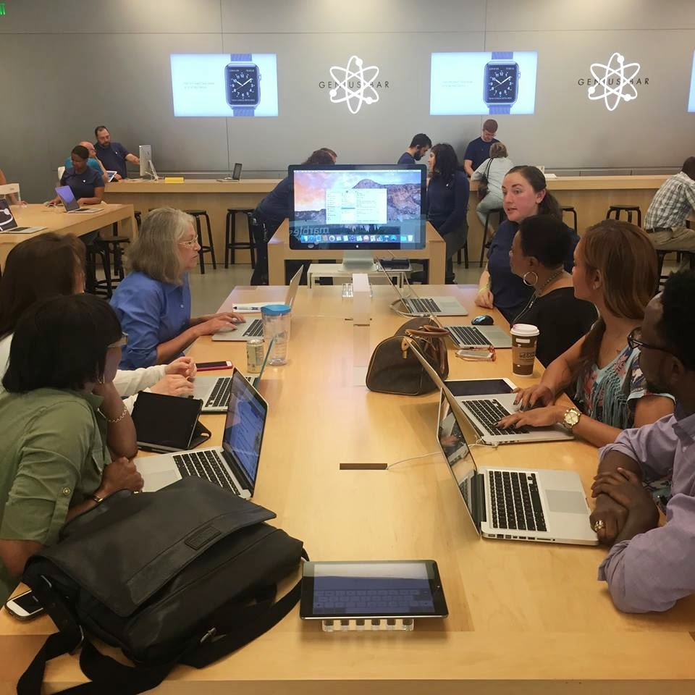
Specialized Training
Apple provides developer documentation, tutorials, and training courses for macOS
Third-party resources and online communities are also available

Slide 12
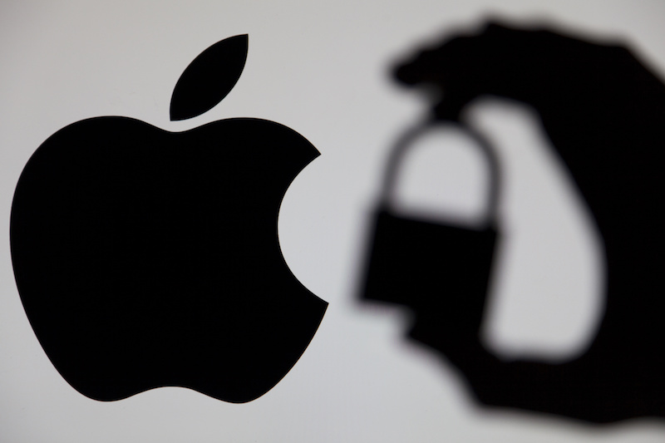
Security Issues
Like any operating system, macOS is susceptible to security vulnerabilities
Apple actively addresses security issues with regular updates and patches
Users should practice good security hygiene and keep their software up-to-date

Slide 13
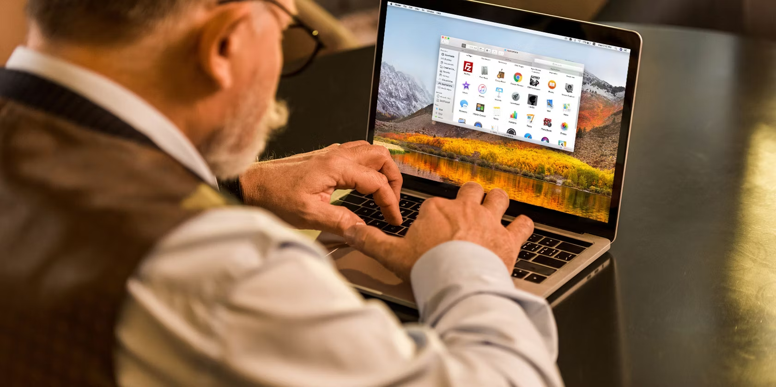
Pros of MacOS
User-friendly interface
Stable and reliable performance
High-quality applications and software integration
Strong focus on security and privacy
Notes:
One of the key strengths of MacOS is its user friendly interface. A familiar and sleek design allows users new and old to easily use the interface. Mac also has remarkably stable performance due to the tight control Apple has over mac software and hardware combinations. This allows them to customize how the OS runs based on which spec of any device you are running MacOS on. Mac is also bundled with a suite of applications that perfectly utilize the resources of the device. Applications like Pages and Keynote are included which isn't the case for many other operating systems. Security and privacy are paramount in macOS. To some the security policies of MacOS may seem limiting, but they allow the device to be much more secure. Mac being run and owned by one company allows them to have a much tighter control of security policies.

Slide 14
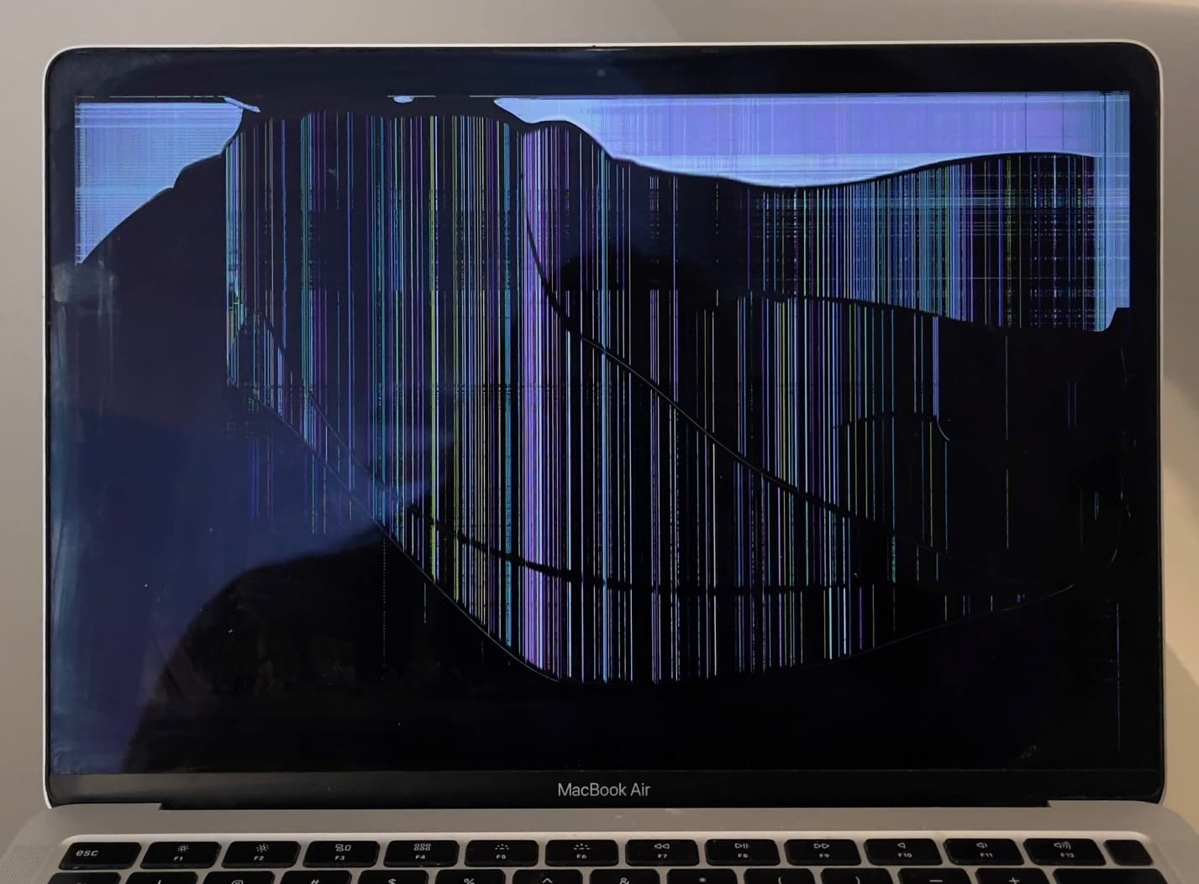
Cons of MacOS
Limited hardware compatibility (compared to Windows)
Higher cost associated with hardware
Lack of some software options compared to Windows
Closed-source nature provides less customization
Cost of Ownership
Notes:
While macOS is optimized for Apple hardware, it does come with limited compatibility compared to Windows. Users may find fewer options when it comes to selecting and upgrading hardware components. MacOS can only legally be run on Apple hardware. One of the drawbacks of macOS is the higher cost associated with Apple hardware. While known for its quality, Apple products may have a premium price tag compared to their Windows counterparts. This significantly increases the barrier to entry of the Mac ecosystem. There is also significantly less software support for Mac, which is most prevalently seen in their almost complete lack of gaming titles that run on the OS. The closed-source nature of macOS limits customization options for users. Unlike open-source systems, macOS has restrictions on modifying core elements, offering less flexibility for advanced users.

Slide 15

Future of MacOS
Apple continues to invest heavily in macOS development
Integration with other Apple services and devices
Continued development of the Apple Silicon platform
Notes:
Apple remains dedicated to the ongoing development of macOS, investing significantly in research, development, and enhancements. Apple annual research and development expenses for 2023 were $29.915B, a 13.96% increase from 2022. macOS seamlessly integrates with other Apple services and devices, creating a unified ecosystem. From iCloud to AirPods, the connection enhances user experience and productivity, as they continue to enhance technologies like HomeKit to better integrate the apple ecosystem with your everyday life. A significant stride in Apple's commitment is the continued development of the Apple Silicon platform. This transition from Intel chips to custom-designed processors signifies Apple's dedication to advancing hardware technology, promising enhanced performance and efficiency for macOS users.

Slide 16
Thank You

Slide 17
Work Cited
https://en.wikipedia.org/wiki/Usage_share_of_operating_systems
https://miro.medium.com/v2/resize:fit:5120/1*dZ7uWTEzFi1Opxw_rKWnsg.jpeg
https://osxdaily.com/2023/06/28/watch-a-visualization-of-the-most-popular-desktop-operating-systems-over-20-years/
https://i0.wp.com/sixcolors.com/wp-content/uploads/2020/08/02-xserveraid_3q.jpeg?ssl=1
https://www.apple.com/newsroom/images/product/imac/standard/apple_new-imac-spring21_mac-family_04202021_big.jpg.large.jpg
https://media.threatpost.com/wp-content/uploads/sites/103/2020/08/31142546/apple-security.jpg
https://www.macscreenrepair.com/wp-content/uploads/2022/11/Lines-on-screen-MacBook-Air-6.jpg
https://www.zdnet.com/a/img/resize/85823bc5d41892a092fb21be0f4254f1d9852b7c/2023/06/07/a8cc81a6-5456-4576-ad17-c616eb8bbf27/dsc09860.jpg?auto=webp&width=1280
https://2.bp.blogspot.com/-tEqpWv6eZrg/VV33OwlI-bI/AAAAAAAABeQ/xMRLf-I2kmE/s1600/Picture%2B2.jpg
https://www.macrotrends.net/stocks/charts/AAPL/apple/research-development-expenses#:~:text=Apple%20annual%20research%20and%20development,a%2016.86%25%20increase%20from%202020.
https://en.wikipedia.org/wiki/MacOS

